Slide 1


SAVITRIBAI PHULE PUNE UNIVERSITY
SAHYADRI VALLEY COLLEGE OF ENGINEERING &
TECHNOLOGY, RAJURI, PUNE (2024-2025)
DEPARTMENT OF COMPUTER ENGINEERING
Submitted to the Department of Computer Engineering, SVCET, Rajuri, Pune, in partial fulfillment of the requirements for the
FINAL YEAR OF COMPUTER ENGINEERING

Slide 2
Content-Based Movie Recommender System
FINAL YEAR PROJECT REPORT
Submitted by:-
Khedkar Laxman
Hase Ashutosh
Langde Ritesh
Mentor Name :- Prof.Khatal K.B
A project submitted in partial fulfillment of the requirements for the Bachelor’s Degree in Computer Engineering awarded by IOST, Savitribai Phule Pune University

Slide 3
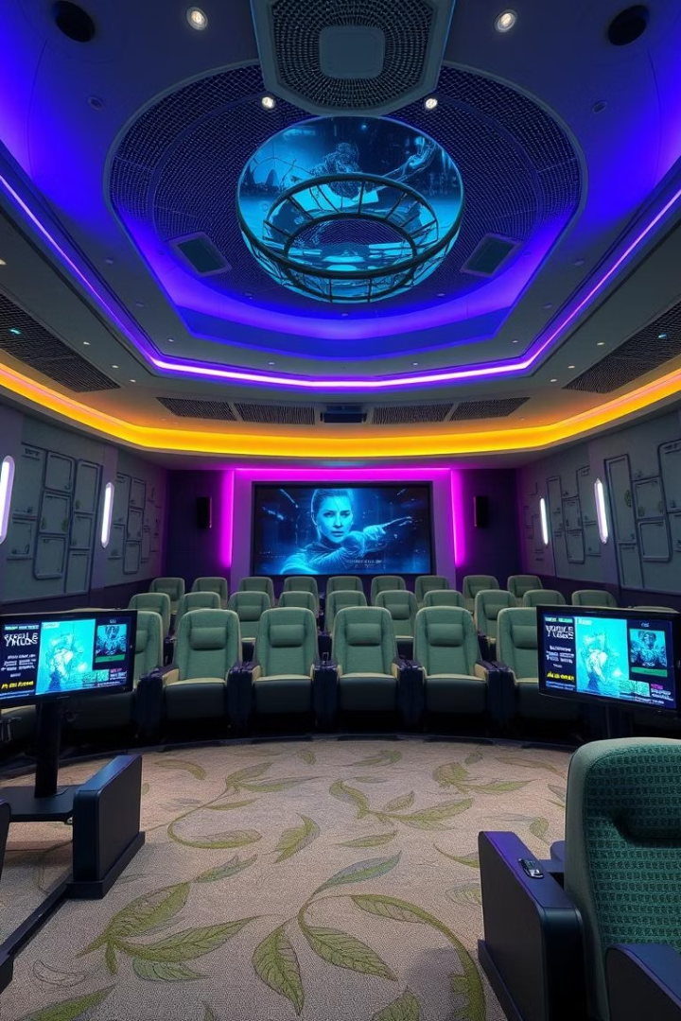
Movie Recommender System
A content-based movie recommender system built in Python, leveraging cosine similarity on text-generated feature vectors to suggest films similar to a user’s chosen title.

Slide 4
Introduction to Recommender Systems
What are they?
Why are they important?
Systems that predict user preferences. They filter information overload. They suggest relevant items.
Enhance user experience. Increase engagement and sales. Personalize content discovery.

Slide 5
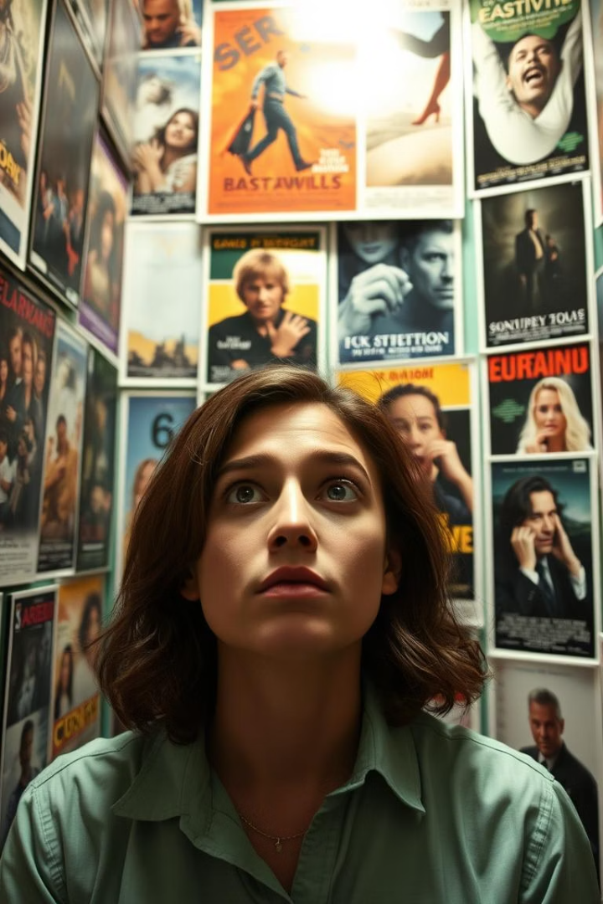
Problem Statement: Finding Relevant Movies
Manual search challenges
Too many options exist. Users face information overload. It is hard to find new films.
Personalized discovery gap
Users often miss relevant movies. Generic lists lack appeal. Discovery is inefficient.

Slide 6

Objectives of Our System
Content-based filtering
Python implementation
Recommend movies based on content. Use genre, cast, and keywords.
Build the system in Python. Leverage its powerful libraries.
Cosine similarity
Measure similarity between films. Identify top matching titles.

Slide 7

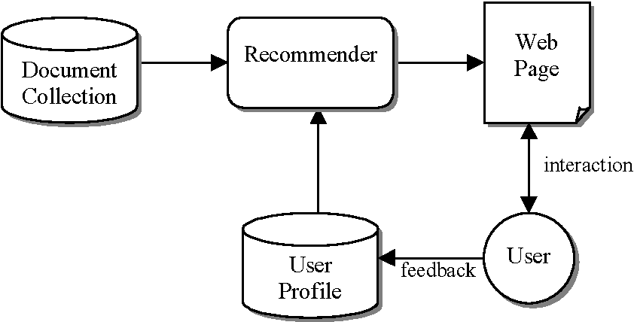



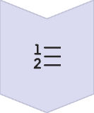
System Architecture Overview
Data Collection
Preprocessing
TF-IDF Vectorization
Cosine Similarity
Top-N Recommendations

Slide 8
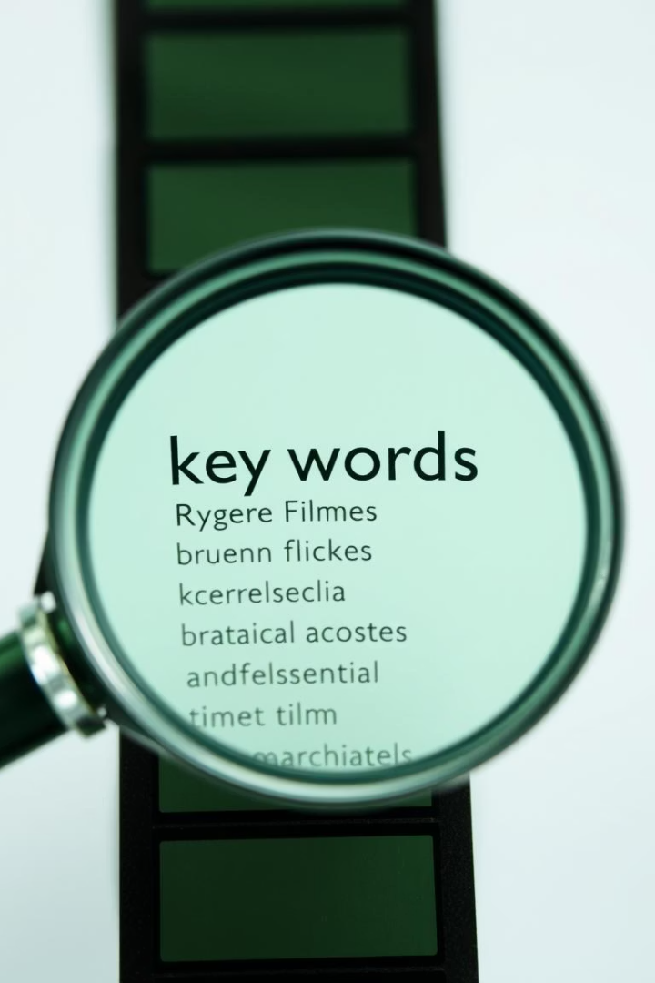



Methodology: Feature Extraction and Similarity
Feature Extraction
Extract genres, cast, keywords, and plot. Aggregate into a single text block per movie.
TF-IDF Vectorization
Convert text to numerical vectors. Use Term Frequency-Inverse Document Frequency.
Similarity Computation
Calculate cosine similarity. Measure angular distance between vectors.

Slide 9








Dataset and Preprocessing
Data Cleaning
Feature Aggregation
Handle missing values. Remove irrelevant data points.
Combine disparate features. Create unified text descriptions.
Dataset Sources
Utilize TMDb and MovieLens. Datasets contain 5,000 movies.
Text Normalization
Convert text to lowercase. Apply stemming or lemmatization.

Slide 10

Working Flow: From Selection to Recommendation
Display Top 5
Compute Cosine Similarity
Present the 5 most similar movie titles.
User Selects Movie
System calculates similarity scores against all movies.
User chooses a movie from a list.

Slide 11
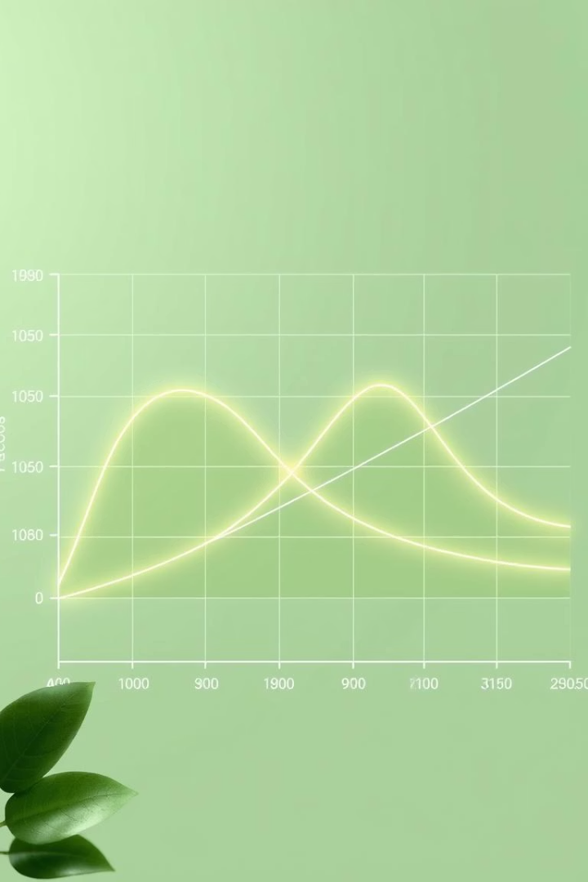
Evaluation and Metrics
90%
85%
87%
Precision
Recall
F1-Score
Measure of relevant recommendations.
Proportion of relevant items found.
Harmonic mean of precision and recall.
We collect user feedback via Streamlit. This data helps refine recommendations.

Slide 12





Conclusion and Future Scope
Summary
Collaborative Filtering
Deep Learning
UI Enhancements
Content-based system works. Cosine similarity is effective.
Explore neural networks. Improve feature representation.
Integrate user behavior data. Enhance recommendation diversity.
Develop interactive front-end. Improve user experience.

